Slide 1
Secure Data Hiding in Images Using Steganography
Presented By : NANDAMURI NAVYA SRI MADHU VIHARIKA
Student Name : NANDAMURI NAVYA SRI MADHU VIHARIKA
College Name & Department : Aditya University / MCA

Slide 2

OUTLINE
Problem Statement
Technology used
Wow factor
End users
Result
Conclusion
Git-hub Link
Future scope

Slide 3
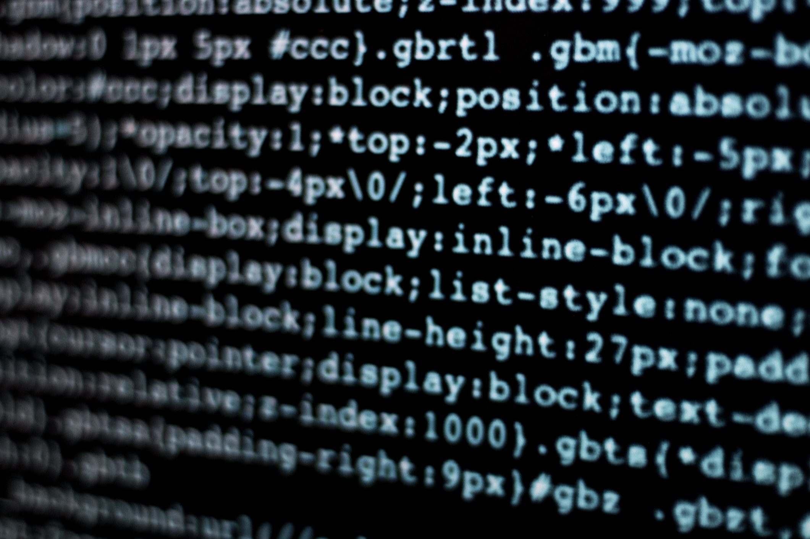
Problem Statement
Why Secure Data Hiding is Needed
Rising Cyber Threats: Data breaches and surveillance necessitate improved security measures.
Encryption Limitations: Traditional encryption signals the presence of sensitive data, making it a target.
Need for Steganography: Hiding data in images adds an additional layer of security

Slide 4
Technology used
Libraries, Algorithms, and Platforms
Programming Language: Python 3 - The backbone of the project, enabling scripting and automation.
Libraries Used: OpenCV (image processing), NumPy (array manipulation), Tkinter (GUI development).
Steganography & Security: LSB Steganography for hidden messages, passcode-based access control.
Development Platform: Windows OS, IDEs like VS Code or PyCharm for coding.
Image Processing Format: Supports JPEG & PNG formats for embedding and extraction.
GUI Framework: Tkinter Notebook for tabbed interface, TTK for modern UI elements.

Slide 5



Wow factors
Unique Aspects of the Project
Dual-Layer Security
Combines steganography with AES encryption for enhanced data protection.
Adaptive Image Selection
Uses Al to determine the best images for embedding hidden messages.
Robust Detection Resistance
Minimizes statistical anomalies, making detection nearly impossible

Slide 6

End users
Who Benefits from This Project?
Government Agencies: Utilized for secure communication and intelligence operations.
Corporations: Protects sensitive business data from industrial espionage.
General Users: Allows individuals to privately communicate without detection.

Slide 7
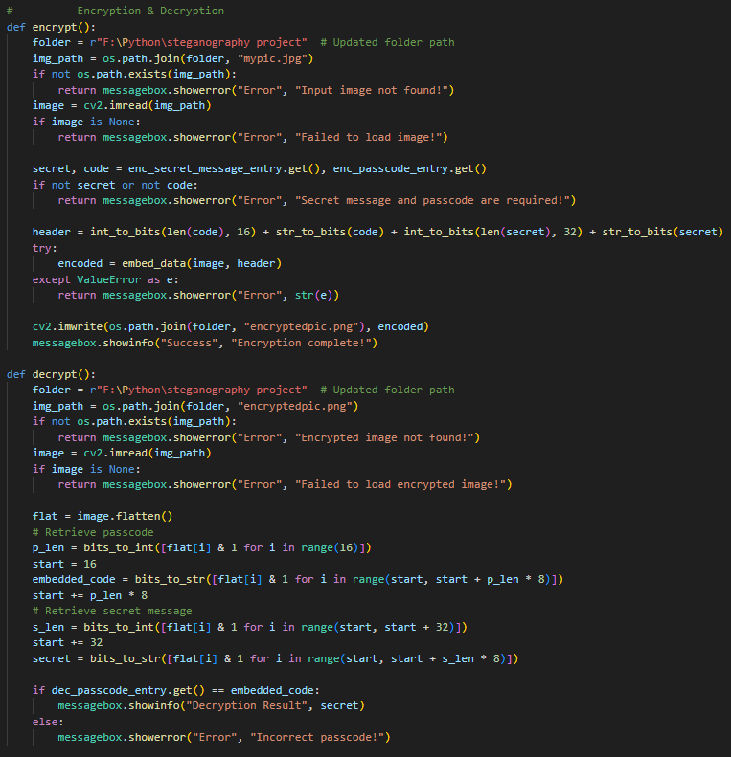

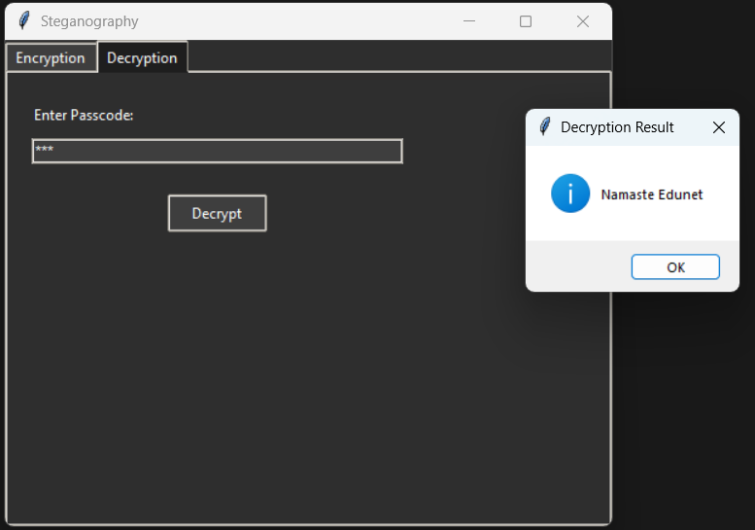

Results
Project Outcome & Screenshots
Output Image
Comparison between the original and steganographed image
Encryption & Decryption code
User Interface Screenshot of the GUI developed with Tkinter
Original Image
Steganographed
Image

Slide 8



Conclusion
Key Takeaways from the Project
Enhanced Data Security
Combining encryption and steganography for improved protection.
Real-World Applications
Useful for secure communication, corporate data protection, and privacy.
Future Enhancements
Potential for Al-driven automation and quantum-safe cryptography.

Slide 9
GitHub Link
https://github.com/MadhuViharikaN/AICTE_Steganography_Project

Slide 10
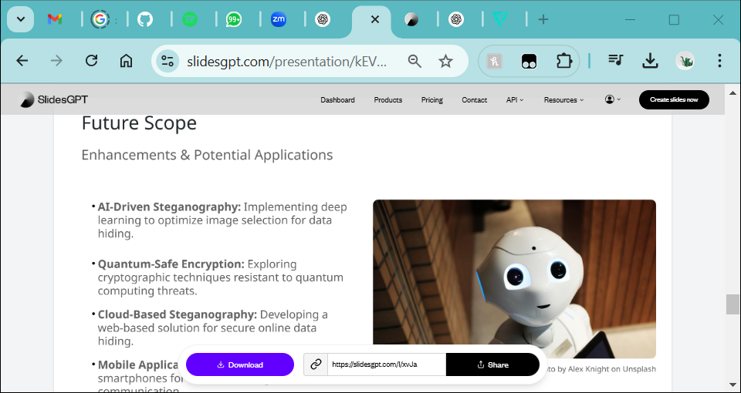
Future scope
Enhancements & Potential Applications
AI-Driven Steganography: Implementing deep learning to optimize image selection for data hiding.
Quantum-Safe Encryption: Exploring cryptographic techniques resistant to quantum computing threats.
Cloud-Based Steganography: Developing a web-based solution for secure online data hiding.
Mobile Application: Bringing steganography to smartphones for secure on-the-go communication.

Slide 11



Thank You
Project Completion
Successful implementation of secure data hiding using steganography.
Open for Questions
Feel free to ask about methodology, implementation, or future work.
GitHub Repository
Find the project source code and documentation online.

